Slide 1
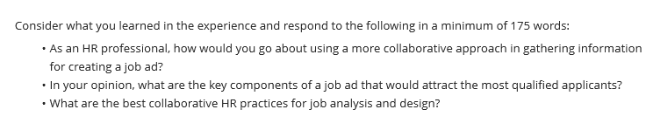
Complete HR Leadership case Study
Answer slide 5, 8 ,11 and 175 words of class discussion and reference should not be part of 175 words

Slide 2


Slide 3


Slide 4


Slide 5
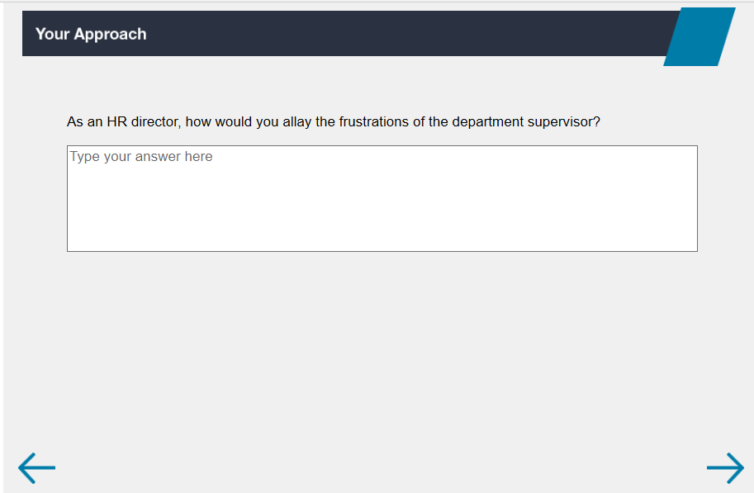

Slide 6
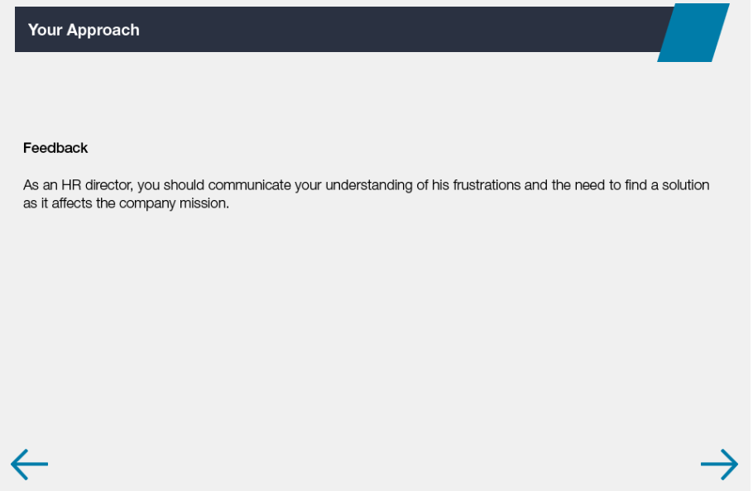

Slide 7
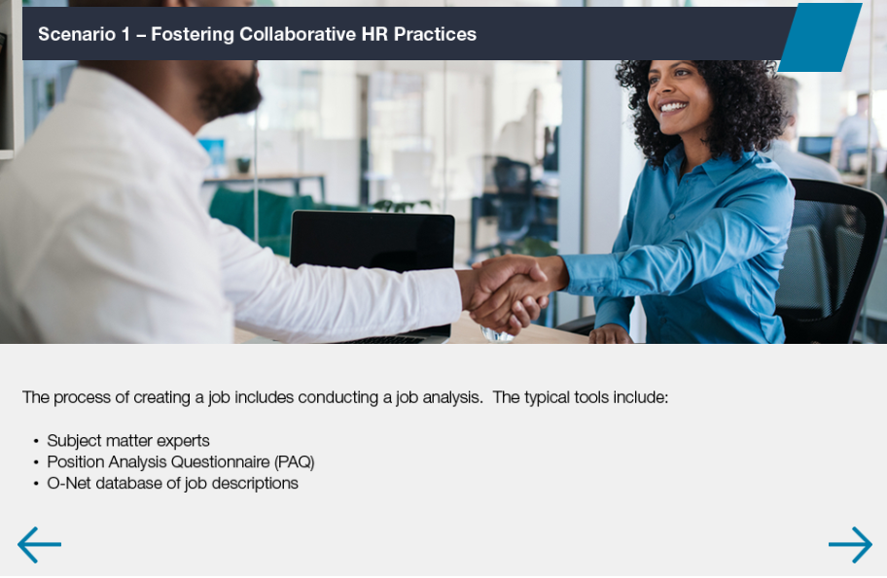

Slide 8
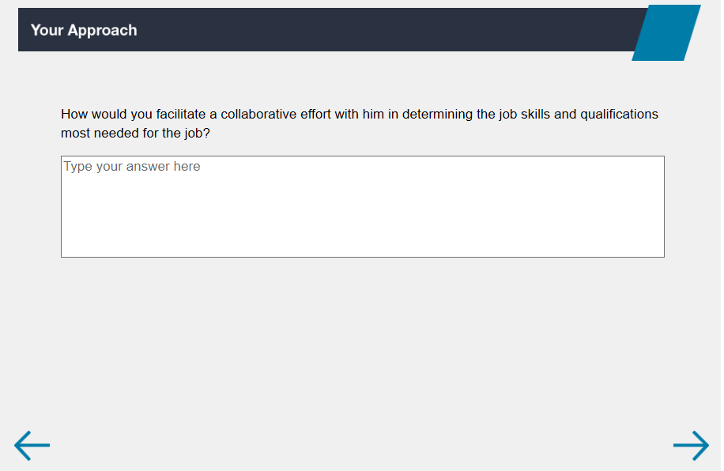

Slide 9
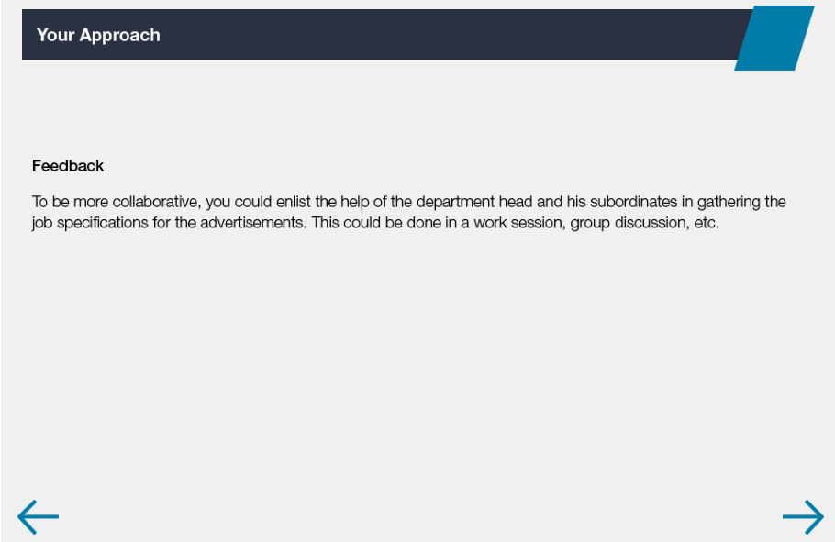

Slide 10


Slide 11
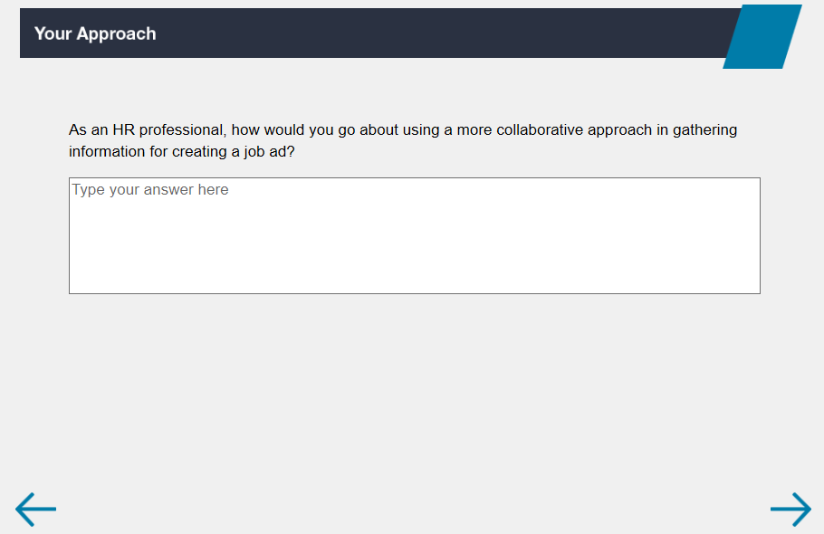

Slide 12
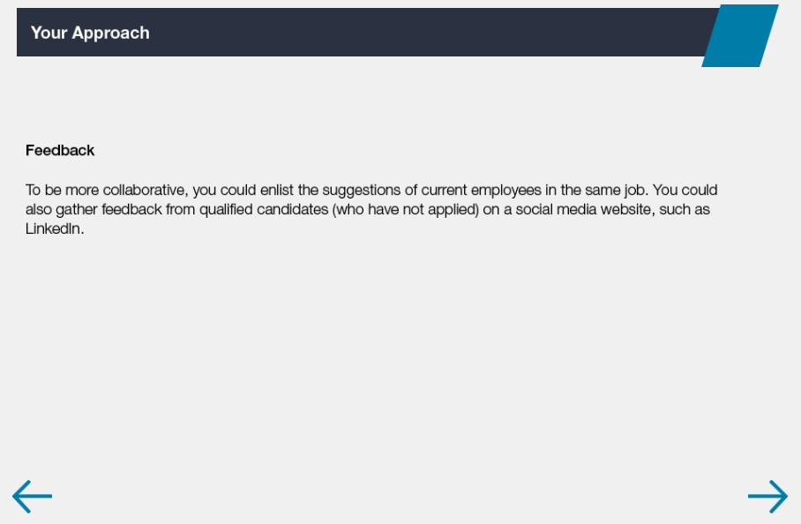

Slide 13


